Slide 2
Thank You
Project Resource is a program of the College for Bishops whose mission and purpose is to support bishops, and therefore, their dioceses, through personal and professional development, strengthening and empowering their vocation of carrying out God’s mission in the world.

Slide 3
Thank You to Our Sponsors!
Vandersall Collective
VandersallCollective.com

Slide 4
Week 4 - Project Resource
Meditation: Matthew 25:14-30
Jesus said, “It is as if a man, going on a journey, summoned his slaves and entrusted his property to them; to one he gave five talents, to another two, to another one, to each according to his ability. Then he went away. The one who had received the five talents went off at once and traded with them, and made five more talents. In the same way, the one who had the two talents made two more talents. But the one who had received the one talent went off and dug a hole in the ground and hid his master’s money. After a long time the master of those slaves came and settled accounts with them.

Slide 5
Week 4 - Project Resource
Then the one who had received the five talents came forward, bringing five more talents, saying, ‘Master, you handed over to me five talents; see, I have made five more talents.’ His master said to him, ‘Well done, good and trustworthy slave; you have been trustworthy in a few things, I will put you in charge of many things; enter into the joy of your master.’ And the one with the two talents also came forward, saying, ‘Master, you handed over to me two talents; see, I have made two more talents.’ His master said to him, ‘Well done, good and trustworthy slave; you have been trustworthy in a few things, I will put you in charge of many things; enter into the joy of your master.’

Slide 6
Week 4 - Project Resource
Then the one who had received the one talent also came forward, saying, ‘Master, I knew that you were a harsh man, reaping where you did not sow, and gathering where you did not scatter seed; so I was afraid, and I went and hid your talent in the ground. Here you have what is yours.’ But his master replied, ‘You wicked and lazy slave! You knew, did you, that I reap where I did not sow, and gather where I did not scatter? Then you ought to have invested my money with the bankers, and on my return I would have received what was my own with interest. So take the talent from him, and give it to the one with the ten talents.

Slide 7
Week 4 - Project Resource
For to all those who have, more will be given, and they will have an abundance; but from those who have nothing, even what they have will be taken away. As for this worthless slave, throw him into the outer darkness, where there will be weeping and gnashing of teeth.’”

Slide 8
Week 4 - Project Resource
Review Weeks 1, 2, & 3:
Week 1: Stewardship as Repair; the Why
Week 2: Donor Characteristics & Stewardship as Pastoral Ministry
Week 3: Annual Giving fits into a Year-Round Plan
Development of theme for annual giving
Begin creation of your year-round calendar

Slide 9
5. Launch and Celebrate
Launch with:
A deadline for pledges (create urgency)
A plan for making 1:1 invitations (remember growth potential)
A robust communications calendar (remember donor needs!)
Weekly updates
Accessible ways to give and pledge
Virtual Binder | Week 4 | Page 1

Slide 10
5. Launch—with intentionality
Post-COVID Reality
You may have new online members—make a plan for their pledge!
Disconnection is still real—reach across the distance.
Online giving means lack of modeling for others to see (chat, make visible the invisible)
Align, align, align your “why” with the needs of your folks!
Virtual Binder | Week 4 | Page 1

Slide 11
Sample Annual Giving Calendar
August
Campaign direct mail warm-up letters to all non-advance campaign prospects.
Continue campaign kick-off plans.
Send second-quarter collections/thank-you letter to all paying donors, confirming pledge and amount paid and pending due.
Say thank you. 1 year-round thanking opportunity.
Virtual Binder | Week 4 | Page 2

Slide 12
Sample Annual Giving Calendar
September
Draft communications: collects, bulletin announcements, and celebrant announcements
Send campaign brochure and pledge cards by direct mail.
Hold stewardship campaign kick-off event!
Say thank you. 1 year-round thanking opportunity.
Virtual Binder | Week 4 | Page 3

Slide 13
Sample Annual Giving Calendar
October
Schedule Ministry Moments.
Send third-quarter collections/thank-you letter to all paying donors confirming pledge and amount paid.
Send thank-you letters within 24 hours of a pledge arrival.
Virtual Binder | Week 4 | Page 3

Slide 14
Sample Annual Giving Calendar
November
Hold celebration event. Mark the end of the campaign!
Bless pledges with a Pledge Blessing Sunday.
Send year-end letters: end-of-the-year gift opportunities for tax benefits.
Send fourth-quarter collections/thank-you letter to all paying donors confirming pledge and amount paid.
Say thank you. 1 year-round thanking opportunity.
Virtual Binder | Week 4 | Page 4

Slide 15
6. Thank and Celebrate
Quiz: How many times do you say “Thank You” per year?
Virtual Binder | Week 4 | Page 5

Slide 16
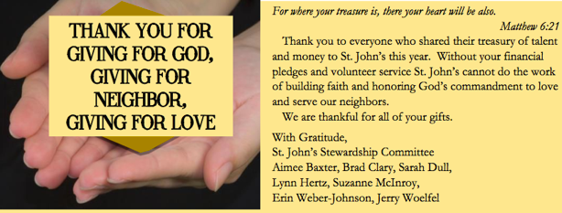
6. Thank and Celebrate
Answer: 7
Virtual Binder | Week 4 | Page 5

Slide 17
6. Thank and Celebrate
How to?
Small reminder gifts
Magnets
Mugs
Dried flowers
Small pictures
Candy bars
100 Grand (first 100k in for budget)
Peppermint Patties (A/C)
Red Hots (heat)
Virtual Binder | Week 4 | Page 5

Slide 18
7. Thank, Thank, & Thank
Thank You
A tool, an act of appreciation, a year-round act.
Virtual Binder | Week 4 | Page 6

Slide 19
7. Thank, Thank, & Thank
Appreciation
Source of education about how gifts were used
Source of education about the institutions
Source of education about new opportunities to give
Theological imperative
Why?
Virtual Binder | Week 4 | Page 6

Slide 20
7. Thank, Thank, & Thank
Assign a vestry member to a ministry
Facebook posts with relevant hashtags
Monthly thank-you texts
Monthly postcards w/faces
How to?
Virtual Binder | Week 4 | Page 6

Slide 21
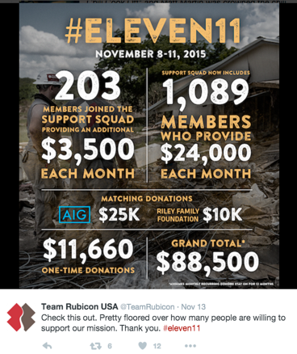
Thanking
How to?
Virtual Binder | Week 4 | Page 6

Slide 22
7. Thank, Thank, & Thank
More How To:
Pictures (when appropriate) from recipients
Thank-you events
Highlight major donor giving in the community as “our parishioners”
Virtual Binder | Week 4 | Page 6

Slide 23
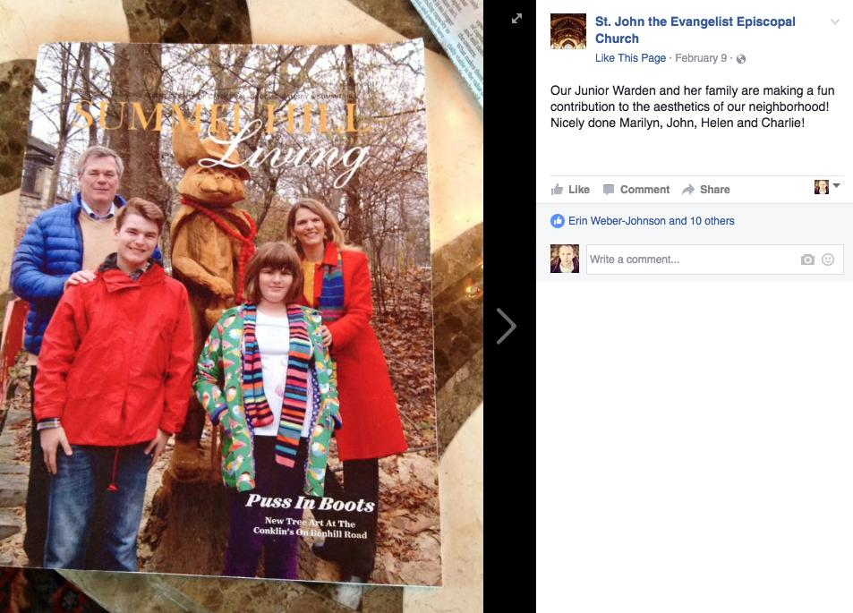
7. Thank, Thank, & Thank
Manual | Day 2 | Page XX
Virtual Binder | Week 4 | Page 6

Slide 24
8. Plan for Next Year
Best Strategy for Giving: Plan Before Fall!
Plan with measurable objectives.
List dates for completion.
Name leaders responsible.
Archive plans for leaders to access year after year.
Create a calendar.
Virtual Binder | Week 4 | Page 7

Slide 25
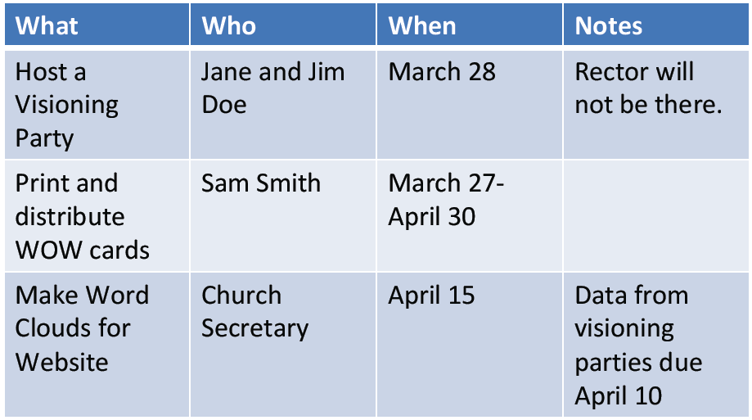
8. Plan for Next Year
When to do it…
Create a calendar
Virtual Binder | Week 4 | Page 7

Slide 26
8. Plan for Next Year
This Year’s Learnings: Next Year’s Strategy
Record what feedback you received.
Record donor information (pastoral concerns, needs named, pertinent information).
Listen to reasons for giving.
Look to see what strategies worked/what didn’t/what could work with adaptation.
Virtual Binder | Week 4 | Page 8

Slide 27
Additional Resources
Lots of Resources in your Virtual Binder!
Virtual Binder | Week 4 | Page 17

Slide 28
SMART Goals
SMART Goals
Specific
Measurable
Assigned to
Realistic
Time specific
Virtual Binder | Week 4 | Page 17

Slide 29
Annual Giving, Part II
Team Exercise:
Set SMART goals together.
Update your year-round calendar with additional steps.

Slide 30
facebook.com/groups/projectresource

