Slide 1
Notes:
Aaron is here; Erin is gone

Slide 2
Thank You
Project Resource is a program of the College for Bishops whose mission and purpose is to support bishops, and therefore, their dioceses, through personal and professional development, strengthening and empowering their vocation of carrying out God’s mission in the world.

Slide 3
Thank You to Our Sponsors!
Vandersall Collective
VandersallCollective.com

Slide 4
Meditation: Joshua 24:1-3a
Annual Giving, Part I
Joshua gathered all the tribes of Israel to Shechem, and summoned the elders, the heads, the judges, and the officers of Israel; and they presented themselves before God. And Joshua said to all the people, “Thus says the Lord, the God of Israel: Long ago your ancestors—Terah and his sons Abraham and Nahor—lived beyond the Euphrates and served other gods. Then I took your father Abraham from beyond the River and led him through all the land of Canaan and made his offspring many.
“Now therefore revere the Lord, and serve him in sincerity and in faithfulness; put away the gods that your ancestors served beyond the River and in Egypt, and serve the Lord. Now if you are unwilling to serve the Lord, choose this day whom you will serve, whether the gods your ancestors served in the region beyond the River or the gods of the Amorites in whose land you are living; but as for me and my household, we will serve the Lord.”

Slide 5
Annual Giving, Part I
Review:
What resonated with you this week as you thought about generational characteristics and your congregation?
Lingering questions?

Slide 6
Annual Giving, Part I
The Why of Annual Giving
Virtual Binder | Week 3 | Page 1

Slide 7
Annual Giving
Annual
Annual giving funds operations
Donor gives from cash flow to fund daily mission & ministry
Capital
Capital campaigns fund specific projects, often related to building
Donor gives from assets to build future/growth of mission
Planned
Planned giving supports ongoing mission
Donor gives from estate to continue church mission
Virtual Binder | Week 3 | Page 1

Slide 8
It’s Personal

Slide 9
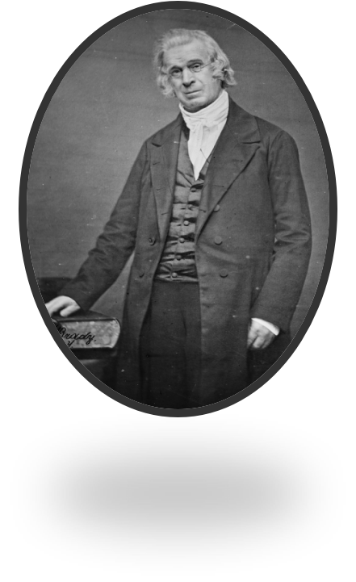
Change Can Be Good
“The [new] system has met with unrivaled success because of its flexibility, accommodating itself to the diversified wants of the various congregations.” How to Pay Church Debts and How to Keep Churches Out of Debt — The Rev. Sylvanus Stall, 1881
Let’s talk about ‘the tithe’...
Virtual Binder | Week 3 | Page 2

Slide 10
The Scarcity Narrative...
“We don’t have enough volunteers, ever.”
“Our parishioners are on limited incomes.”
“Our parishioners are elderly or disabled or just tired.”
Virtual Binder | Week 3 | Page 2

Slide 11
Change the Narrative...
Keeping our eyes on the Whys
Everyone in this congregation believes in the Why we have articulated — so everyone should be part of how we accomplish that. Invite everyone into the process.
We are shifting from How much can you give to Why do you give. Does that change your priorities at all?
What gives you joy in this congregation? How can you use that joy to support it?
Virtual Binder | Week 3 | Page 2

Slide 12
Getting Started
Getting Started
Choose a Leader
Listen & Plan
Develop a Theme
Plan a Communications Strategy
Virtual Binder | Week 3 | Page 3

Slide 13
Choose a Leader
Virtual Binder | Week 3 | Page 4

Slide 14
Choose a Leader
Virtual Binder | Week 3 | Page 4

Slide 15
Choose a Leader
Presenting: Your Annual Giving Chair!
Virtual Binder | Week 3 | Page 4

Slide 16
The Annual Giving Volunteer is a Cheerleader!
Choose a Leader
They keep the why top of mind.
They are also grateful.
They may be asked to help you identify the impact statements.
They are organized (they will be riding herd on the communications calendar).
They are computer literate.
They are willing to throw a party.
They will work with a partner.
Virtual Binder | Week 3 | Page 4

Slide 17
Annual Giving is a
Conversation
2. Listen & Plan
First there is listening…
As many ways as you can.
As many people as you can.
As often as you can.
Virtual Binder | Week 3 | Page 7

Slide 18
Annual Giving is a
Conversation
2. Listen & Plan
Then there is reporting back...
As often as you can.
In as many various ways as
you can.
Virtual Binder | Week 3 | Page 7

Slide 19
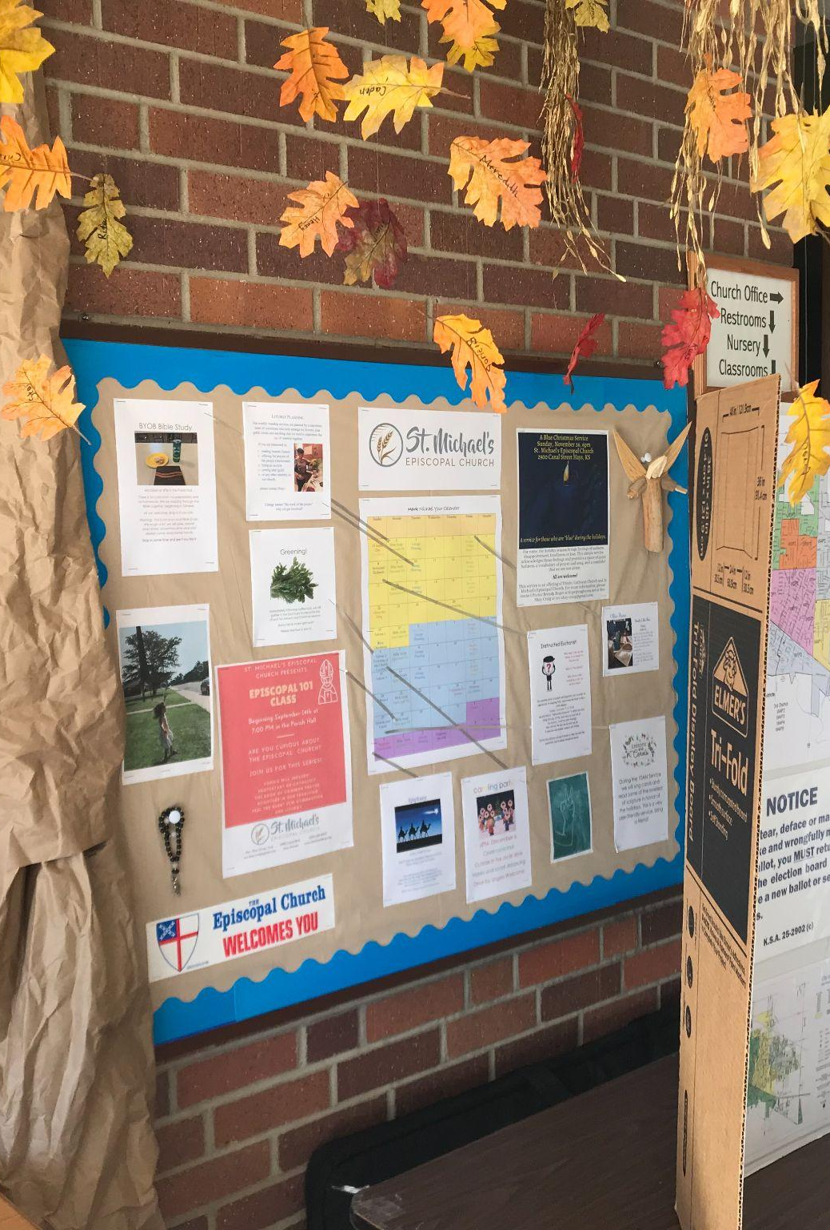
2. Listen & Plan
Data Gathering
Inviting your congregation into conversations
Pew Cards
Gatherings (actual and/or virtual)
Social Media
Written, Spoken, Art, Music...
Where do you hear it? Success is contextual
Virtual Binder | Week 3 | Page 7

Slide 20
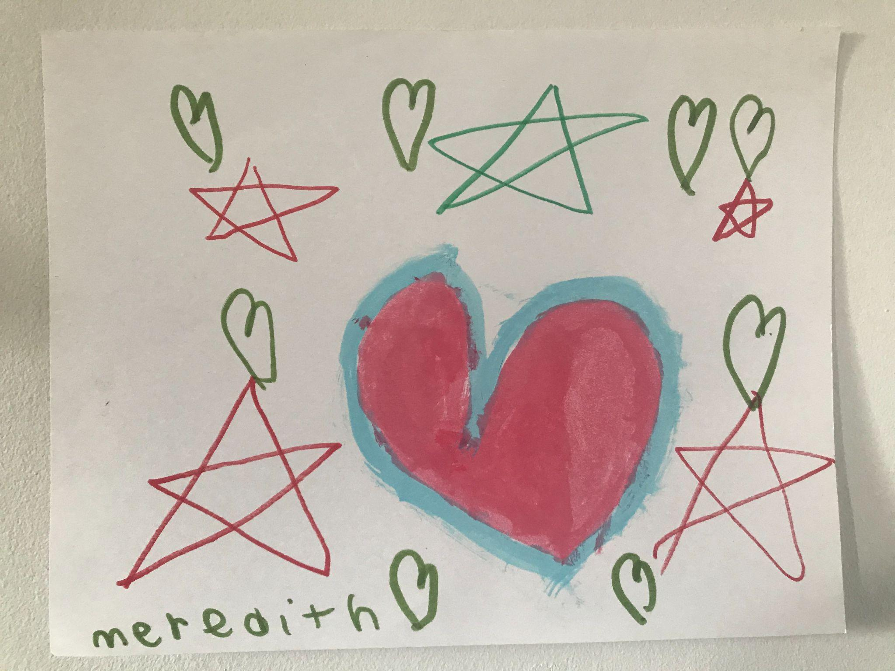

Slide 21
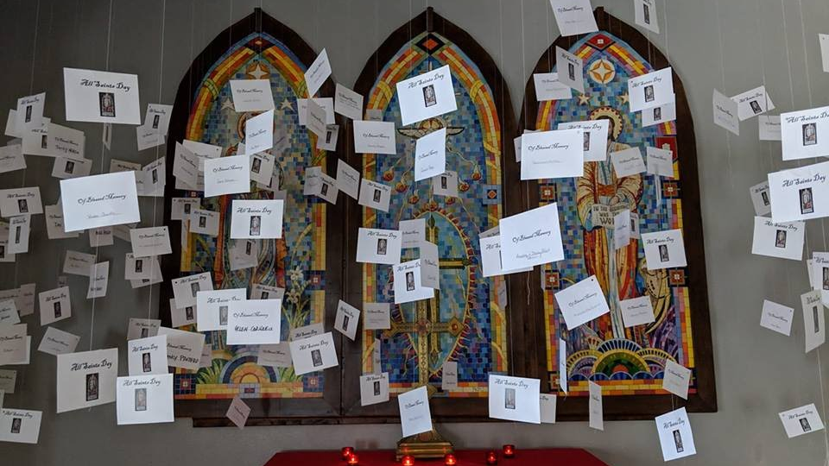

Slide 22
2. Listen & Plan
Data Gathering
Segment your congregation
Segment based on demographics, needs, and who you have identified yourselves to be and what your unique needs are
Virtual Binder | Week 3 | Page 7

Slide 23
3. Develop a Theme
Ask Questions
Listen
Pray
Look
Virtual Binder | Week 3 | Page 8

Slide 24
3. Develop a Theme
“Today you are you, that is truer than true.
There is no one alive who is youer than you.” - Dr. Seuss
Virtual Binder | Week 3 | Page 8

Slide 25
3. Develop a Theme
What was your best theme that you’ve used?
Why was it successful?
Virtual Binder | Week 3 | Page 9

Slide 26
3. Develop a Theme

Slide 27
3. Develop a Theme

Slide 28
3. Develop a Theme

Slide 29
3. Develop a Theme

Slide 30
3. Develop a Theme

Slide 31
3. Develop a Theme
Theme ideas should be simple, clear, and easy to remember
Theme ideas should tie into meaning-making
Virtual Binder | Week 3 | Page 10

Slide 32
3. Develop a Theme
Focus Groups
How could a focus group help you discover your theme?
Virtual Binder | Week 3 | Page 11

Slide 33
4. Plan a Communications Strategy
Voice
3rd-person narrative.
the voice of a child thanking the parish for their future spiritual home.
a collection of first-person narratives from parishioners.
Virtual Binder | Week 3 | Page 13

Slide 34
4. Plan a Communications Strategy
Response
Mailing Lists...are they clean?
Would having a postage paid return envelope make it easier for them to return?
Is Online Pledging an option? Is it easy to navigate?
Post-COVID, do you have different audiences? (ie Online/Virtual Church Community vs In-Person Church Community)
Do your communications platforms need to change in a post-COVID world?
Virtual Binder | Week 3 | Page 13

Slide 35
4. Plan a Communications Strategy
Quality
Excellence is important!
Would you be inspired to make a donation by a campaign that is poorly thought out and communicated?
Virtual Binder | Week 3 | Page 13

Slide 36
4. Plan a Communications Strategy
Communications Channels
Case Brochure
eNewsletters
Website
Bulletins
Sermons
Verbal Announcements
Videos
Social Media
Potty Posters
Postcards
Posters
Banners
Ministry Moments
Texting
Zoom
Virtual Binder | Week 3 | Page 14

Slide 37
CaffeinatedChurch.org

Slide 38
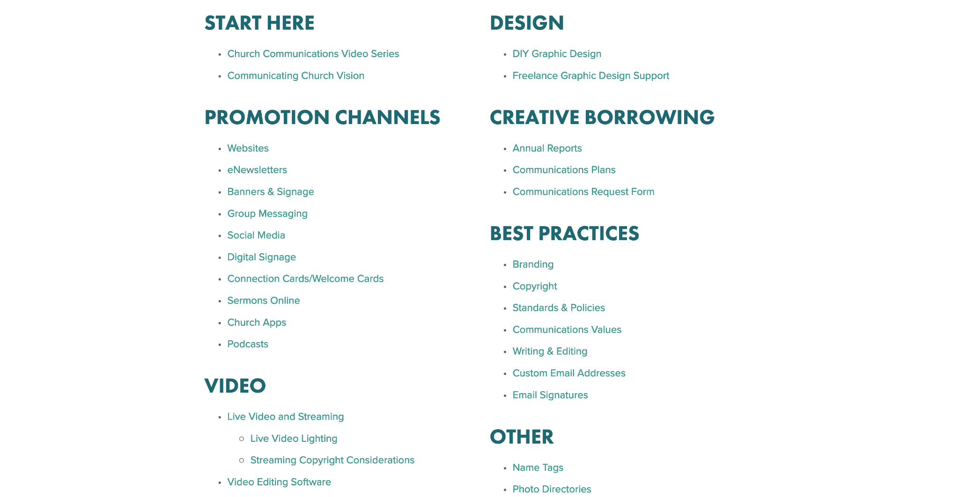
CaffeinatedChurch.org

Slide 39
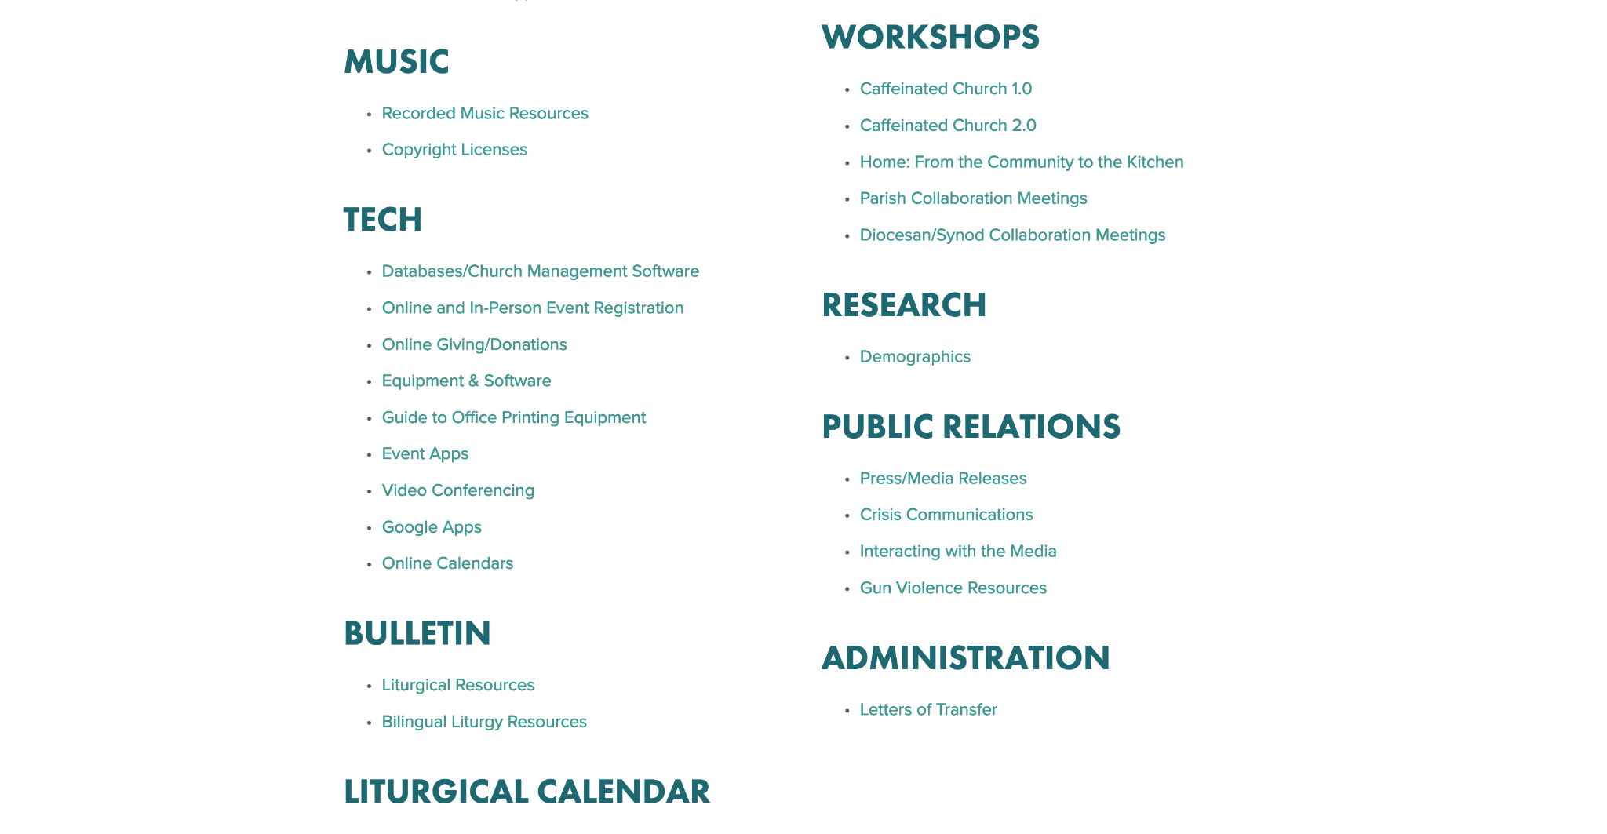
CaffeinatedChurch.org

Slide 40
4. Plan a Communications Strategy
Pledge Cards & Online Giving
physical pledge cards
online pledging
Virtual Binder | Week 3 | Page 15

Slide 41
4. Plan a Communications Strategy
Impact Statement
Communicates to the stakeholders in your organization that their gift has made a difference.
Gives tangible evidence of that impact.
Reminds the donor not of what they gave, but why they gave.
Connects the dots between their gift and the Why.
Virtual Binder | Week 3 | Page 17

Slide 42
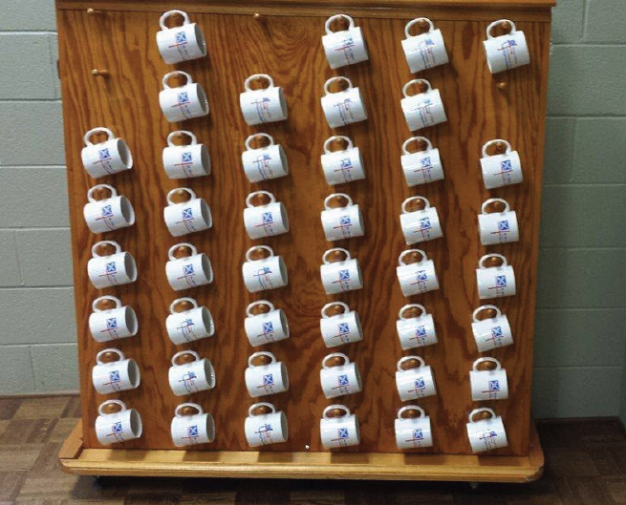
4. Plan a Communications Strategy
Impact Statements: The Difference You Have Made
We have shared 2,500 cups of coffee together. #fellowship@St.Marys
Virtual Binder | Week 3 | Page 17

Slide 43
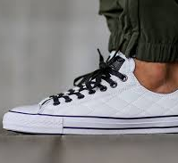
Christ Church is Walking the Walk
in our Community
4. Plan a Communications Strategy
Did you know:
220 feet come in and out of our doors each week.
30 people every Sunday.
20 AA members.
25 Wiggle Worms.
10 members at Bible Study Thursdays.
12 members at Bible study Fridays.
3 Knitting Club members.
10 Boy Scouts.
Virtual Binder | Week 3 | Page 17

Slide 44
Ministry Moments
A Ministry Moment is a time in each service during your pledge campaign where a parishioner gives a personal testimony to the impact of mission and ministry of the church.
Visuals are better.
Record them!
Pay attention to representation.
Scripts/talking points can be useful.
Virtual Binder | Week 3 | Page 18

Slide 45
Ministry Moments
Ministering to Ministry Moment Ministers
Help to to feel prepared.
Give them guard rails.
Give them plenty of time to prepare
Welcome them and get them settled
Walk them through the process
Be sure they have water
Thank them profusely
Ask them what they would have done differently.
Thank them again.
One more thanks can’t hurt.
Virtual Binder | Week 3 | Page 19

Slide 46
4. Plan a Communications Strategy
“None of this could have been possible
without your financial support.
Thank you.”
Virtual Binder | Week 3 | Page 19

Slide 47
Your Year-Round Calendar
When?
When in the year will you have your campaign?
What other big events are coming during the year?
When will you recruit your stewardship committee members?
When will you begin data gathering to begin formulating your campaign?
Virtual Binder | Week 3 | Page 20

Slide 48
Your Year-Round Calendar
When?
When will you begin developing your theme?
When is the deadline to have your theme figured out?
When will you organize your mailing lists?
When will you begin planning what communications platforms you will use to communicate your campaign?
Virtual Binder | Week 3 | Page 20

Slide 49
Annual Giving, Part I
Team Exercise:
Development of your theme for annual giving
Begin creation of your year-round calendar
Virtual Binder | Week 3 | Page 20

Slide 50
Thank You to Our Sponsors!
Vandersall Collective
VandersallCollective.com

