Slide 2
Thank You
Project Resource is a program of the College for Bishops whose mission and purpose is to support bishops, and therefore, their dioceses, through personal and professional development, strengthening and empowering their vocation of carrying out God’s mission in the world.

Slide 3
Thank You to Our Sponsors!
Vandersall Collective
VandersallCollective.com

Slide 4
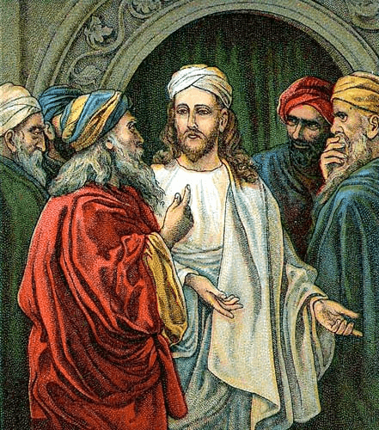
Meditation- The Greatest Commandment
Matthew 22:34-46
Photo by Jonathan Kemper on Unsplash

Slide 5
Review Week 1
Money narratives: what do we carry and what needs to be released?
A theology of table building
Fundraising as a ministry
What is the “Why”
Virtual Binder | Week 2 | Page 1

Slide 6
Starting with Why
Week 1 Team Exercises: Releasing and Reimagining Together
How do you presently think about, describe, and understand fundraising? What do you need to release, reimagine, and/or practice to view fundraising as a ministry?
What is your “Why”?
If a million dollars was the result of a focused effort of stewardship at your church, what would that look like?
Virtual Binder | Week 1 | Page 8

Slide 7
The Ministry of Giving:
A reminder as we begin this week:
Sharing/Repairing of the World
Table making
When fundraising is ministry, lives are transformed in the giving of gifts to change and repair a broken world as we reconcile ourselves to God.
Virtual Binder | Week 1 | Page 4

Slide 8
Week 2 - Project Resource
New donor motivations = Pastoral Needs
What has changed in light of the cascading crises of the past few years?
Virtual Binder | Week 2 | Page 1

Slide 9
Week 2 - Project Resource
New donor motivation #1 = Meaning Making
A phase of grief
Virtual Binder | Week 2 | Page 1

Slide 10
Week 2 - Project Resource
New donor motivation #2 = Rage/Catharsis
Occurred prior to COVID, re-emerging as phase of grief
Virtual Binder | Week 2 | Page 1

Slide 11
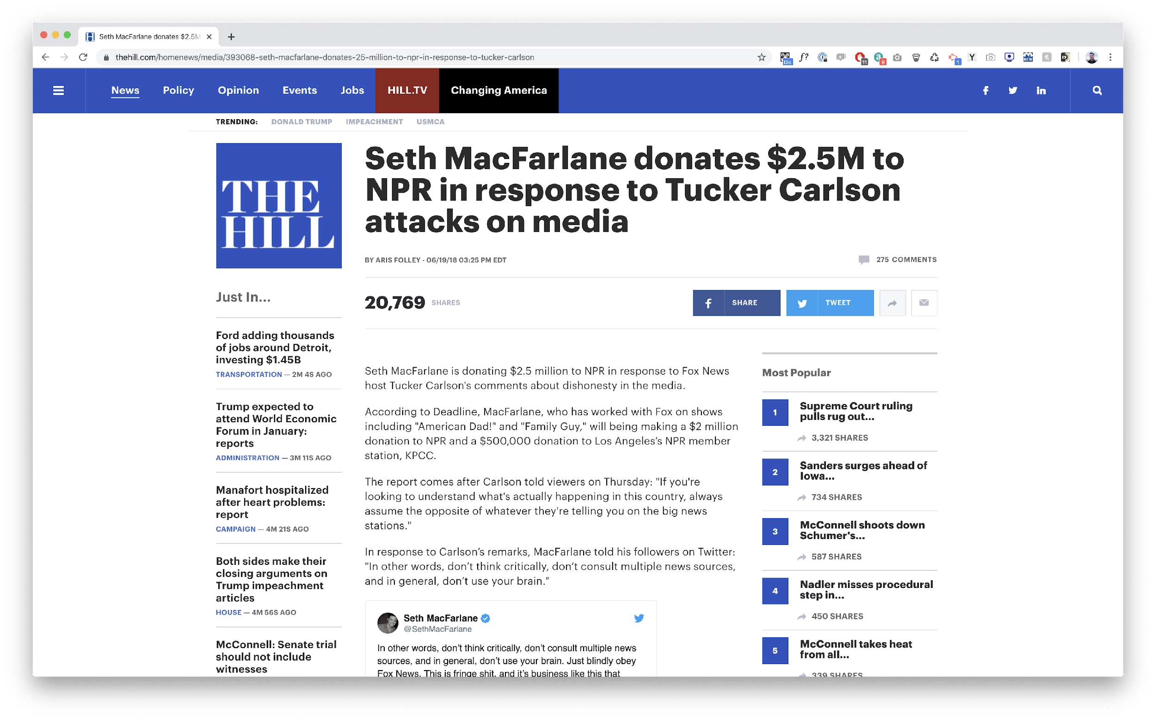
Week 2 - Project Resource
Occurred prs phase of grief

Slide 12
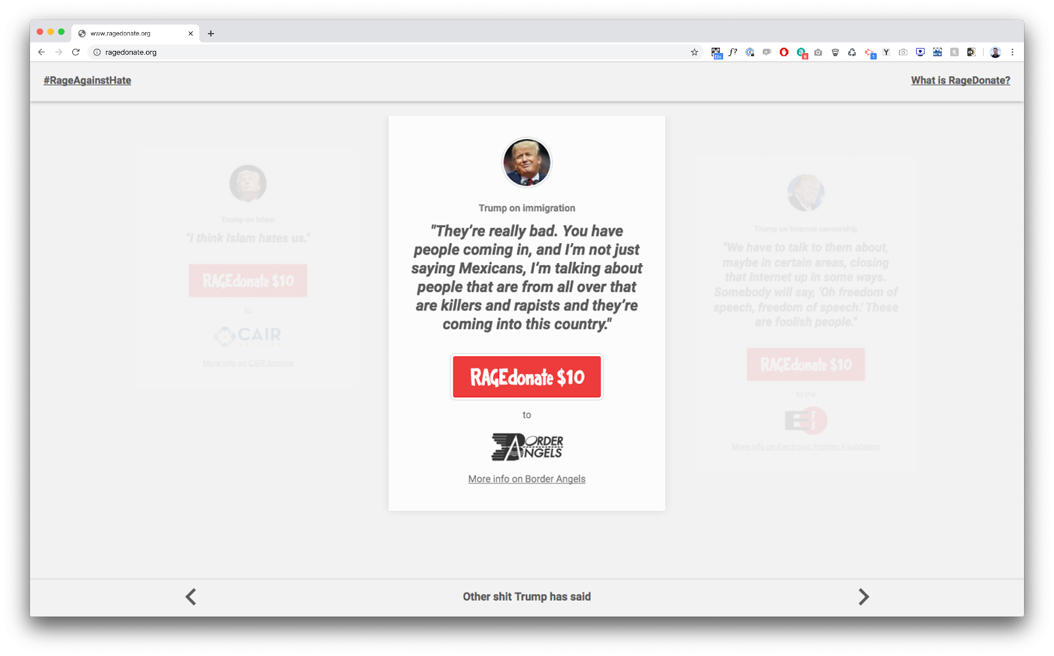
Week 2 - Project Resource

Slide 13
Week 2 - Project Resource
New donor motivation #3 = Agency/Social Injustice
Virtual Binder | Week 2 | Page 1

Slide 14
Donor Characteristics
A Reminder:
When stewardship is ministry, lives are transformed in the giving of gifts to change and repair a broken world as we reconcile ourselves to God.
Virtual Binder | Week 2 | Page 1

Slide 15
Donor Characteristics
How do you know what your folks need?
Ask
Listen
Respond
Virtual Binder | Week 2 | Page 1

Slide 16
Donor Characteristics
Where is there data on Christian Communities of Color?
Virtual Binder | Week 2 | Page 1

Slide 17
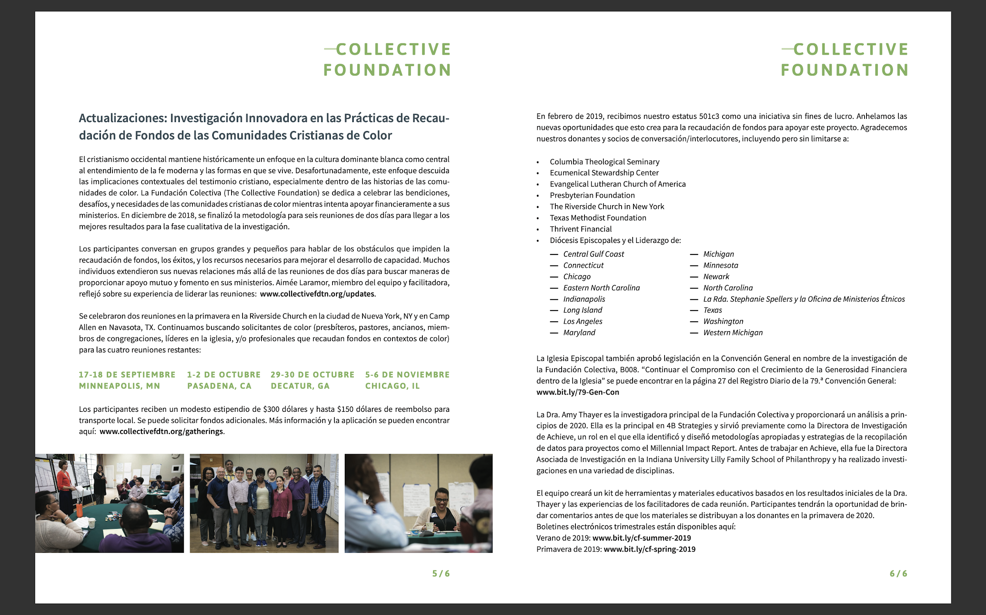
Collective Foundation
Report: https://collectivefdtn.org/report

Slide 18
Generational Characteristics
Some Quick Definitions:
“Generalizations make sense when talking about thousands of people, but not when talking about one person — the person you know. Applying a valid statistical generational characteristic to one person is stereotyping.”
— Haydn Shaw
Virtual Binder | Week 2 | Page 1

Slide 19
Donor Characteristics
Generational Characteristics: Not a magic bullet, but a helpful resource tool to think about giving strategies.
Updated cohorts from Pew as of 2021:
Silent Generation: 1928-1945
Baby Boomer: 1946-1964
Generation X: 1965-1980
Millennial: 1981-1996
Generation Z: 1997-2012
Virtual Binder | Week 2 | Page 1

Slide 20
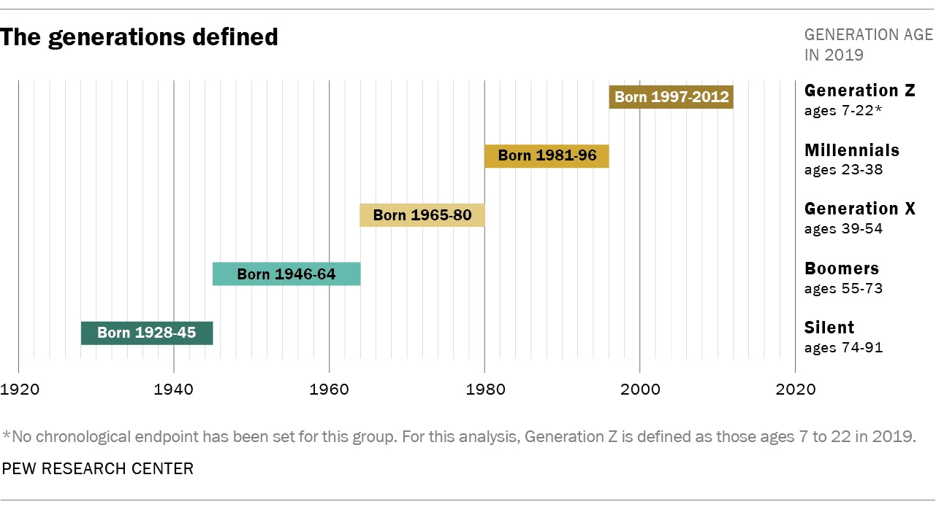
Donor Characteristics
Virtual Binder | Week 2 | Page 1

Slide 21
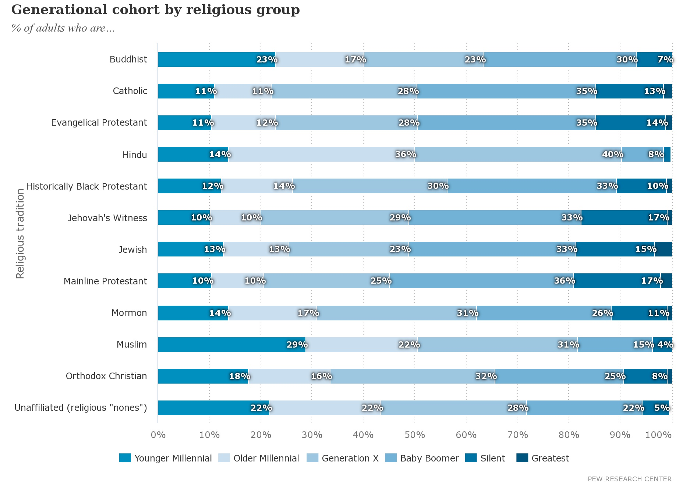
The Religious Landscape Study, Pew Research Center, downloaded November 17, 2021. https://www.pewforum.org/about-the-religious-landscape-study/
Manual | Day 1

Slide 22
Generational Characteristics
Silent Generation: 1928-1945
Defining cultural moments:
WWII: The move from rural to urban, the rise of the single authority/expert by radio, japanese encampments
GI Bill: Inequity of wealth/opportunity distribution
Greatest Depression: collective suffering, redlining
Virtual Binder | Week 2 | Page 3

Slide 23
Generational Characteristics
Silent Generation: 1928-1945
Defining Characteristics:
Value uniformity, loyalty, “if everyone did their part.”
MESSAGE: Legacy, faithful stewardship of resources
STRATEGY: Authority figure/Voice of the expert
Virtual Binder | Week 2 | Page 3

Slide 24
Generational Characteristics
Silent Generation: 1928-1945
If your church or institution has a significant number, you may hear the language of giving of
“If we all do our part” or
“I give because so much has been given to me” or
“I sacrifice because its what is expected.”
Virtual Binder | Week 2 | Page 3

Slide 25
Generational Characteristics
The Baby Boomer Generation: 1946-1964
Defining Cultural moments:
Vietnam War/WaterGate
Civil Rights Movement
Shift from Church as center of community
Start of philanthropic redlining
Shift from single authority to multiple authority
Virtual Binder | Week 2 | Page 3

Slide 26
Generational Characteristics
The Baby Boomer Generation: 1946-1964
Defining Characteristics:
Care of self is more important than uniformity
Need information on impact/how gift will be used.
Need for transparency in light of mistrust of institutions
Virtual Binder | Week 2 | Page 3

Slide 27
Generational Characteristics
The Baby Boomer Generation: 1946-1964
MESSAGE: 1.) Use of gift impactfully/wisely and 2.) Prioritization of Giving
STRATEGY: “Trust indicator”, like charity navigator rating or endorsement, when possible, transparent money narrative budgets, drop any language of obligation, regular check in’s to share impact of gift
Virtual Binder | Week 2 | Page 3

Slide 28
Generational Characteristics
Baby Boomer: 1946-1964
If your church or institution has a significant number, you may hear the language of giving of
“We are faithful stewards of God’s gifts” or
“We are part of a community and know it will make an impact” or “We give to invest back what has been given to us.”
Virtual Binder | Week 2 | Page 3

Slide 29
Generational Characteristics
How would your invitation to a Greatest Generation/Mature potential donor look different from that of a Baby Boomer?
Virtual Binder | Week 2 | Page 3

Slide 30
Generational Characteristics
Generation X: 1965-1980
Defining Cultural moments:
End of Cold War
Latchkey Kids
First Generation to not do as well financially as their parents
The tech Revolution
War on Drugs
Rise of the personal computer
Will move 5 + times over the course of their career
Virtual Binder | Week 2 | Page 3

Slide 31
Generational Characteristics
Generation X: 1965-1980
Defining Characteristics
Experience tied to giving
Wish to “experience” church, though may not attend regularly
Experience is tied to relationship, giving is supported when leaders are seen rather than institutions
Virtual Binder | Week 2 | Page 3

Slide 32
Generational Characteristics
Generation X: 1965-1980
MESSAGE: We are a people/community who care about each other. Put individuals in front of ministries/institutions.
STRATEGY: Year-round thinking on giving. Don’t just focus on the fall. Focus on peer-to-peer experience.

Slide 33
Generational Characteristics
Generation X: 1965-1980
If your church or institution has a significant number, you may hear the language of giving of
“We give because we know ____uses these to make an impact” or
“We give as we’ve experienced the power of God’s love and want others to know it” or
“We give to tell us who we are together.”
Virtual Binder | Week 2 | Page 3

Slide 34
Generational Characteristics
How would your invitation to a Generation X potential donor look different from that of a Baby Boomer?
Virtual Binder | Week 2 | Page 4

Slide 35
Generational Characteristics
Millennial Generation: 1980-1996
Defining Cultural Moments:
9/11
Stock market crash of 2008
War in Afghanistan and Iraq
Obama Election
Murders of Michael Brown, George Floyd, and so many other people of color by those in positions of authority
First Generation of “scheduled” children
Virtual Binder | Week 2 | Page 3

Slide 36
Generational Characteristics
Millennial Generation: 1980-1996
Defining Characteristics :
Pew points to similar characteristics as silent generation
Mentor relationships important with giving
Authority/experts shift the level of trust
Want to feel their gifts matter rather than used wisely or encounter a bad experience
Virtual Binder | Week 2 | Page 3

Slide 37
Generational Characteristics
MESSAGE: Your giving matters and will make an impact. Now, how do we get to know you?
STRATEGY:
Immediate gratification of giving.
Online community presence.
Online stories of impact.
Use them for focus groups, ask their opinions.
Put them in charge of using technologies for appeals. No long appeal letters.
Utilize their networks. Have them plan events that interest them.
Virtual Binder | Week 2 | Page 5

Slide 38
Generational Characteristics
Millennials: 1980-1996
If your church or institution has a significant number, you may hear the language of giving of
“We believe in impacting change through giving ” or
“ Each person giving makes a difference as we grow and learn together.”
Virtual Binder | Week 2 | Page 3

Slide 39
Generational Characteristics
Generation Z : 1997-2012
Defining Cultural Moments :
Trump’s Election
Covid 19 Pandemic
Virtual schooling
Smart Phone/Mobile First/Text First
Social Networking
Climate Change
Virtual Binder | Week 2 | Page 3

Slide 40
Generational Characteristics
Generation Z : 1997-2012
Defining Giving Characteristics:
Blackbaud and QGiv report increased giving in summer and holiday seasons. When not in school, they want to be involved and engaged.
This group of donors is the most willing to get involved in advocating for their favorite nonprofits; 84% of Generation Z donors say they’re willing to raise money for their favorite causes
While their assets are smaller, this generation indicates that philanthropy and service is of significant importance to them.
Virtual Binder | Week 2 | Page 3

Slide 41
Generational Characteristics
Generation Z : 1997-2012
MESSAGE: We know there is so much out there that is difficult. But, we believe, with your help that we can change the world together.
STRATEGY: A independent led fundraiser in honor of their birthday or milestone online
Virtual Binder | Week 2 | Page 3

Slide 42
Generational Characteristics
Generation Z: 1997-2012
If your church or institution has a significant number (likely not, but we hope one day!), you may hear the language of giving of
“Our gifts can change the world. We have the power to do this today, together.”
Virtual Binder | Week 2 | Page 3

Slide 43
Generational Giving
What is the Why? Strategy changes, the Why remains.
“What finally brought me back, after years of running away, wasn’t lattes or skinny jeans; it was the sacraments. Baptism, confession, Communion, preaching the Word, anointing the sick — you know, those strange rituals and traditions Christians have been practicing for the past 2,000 years. The sacraments are what make the church relevant, no matter the culture or era. They don’t need to be repackaged or rebranded; they just need to be practiced, offered and explained in the context of a loving, authentic and inclusive community. “
— Rachel Held Evans
Virtual Binder | Week 2 | Page 13

Slide 44
Generational Giving
Cross-Generational Giving
Are there strategies that work…with a different audience?
Videos
Mission Moments
Emails
Letters
Representation rather than perfection matters.
Virtual Binder | Week 2 | Page 13

Slide 45
Generational Giving: Your Letter for all
Who are in your “pews”?
Based on your data, what messages need to be heard?
What would a letter look like from your parish?
Virtual Binder | Week 2 | Page 13

Slide 46
Generational Giving
Team Exercise: Describe Your Generational Characteristics What are the generational characteristics of your church?
Who are in your pews?
Based on your data, what messages need to be heard?
What would a letter look like from your parish?
Virtual Binder | Week 2 | Page 13

Slide 47
Thank You to Our Sponsors!
Vandersall Collective
VandersallCollective.com

