Slide 2
Thank You
Project Resource is a program of the College for Bishops whose mission and purpose is to support bishops, and therefore, their dioceses, through personal and professional development, strengthening and empowering their vocation of carrying out God’s mission in the world.

Slide 3
Thank You to Our Sponsors!
Vandersall Collective
VandersallCollective.com

Slide 4
Week 1 - Project Resource
Meditation

Slide 5
Meditation
Philippians 4:1-9 My brothers and sisters, whom I love and long for, my joy and crown, stand firm in the Lord in this way, my beloved. I urge Euodia and I urge Syntyche to be of the same mind in the Lord. Yes, and I ask you also, my loyal companion, help these women, for they have struggled beside me in the work of the gospel, together with Clement and the rest of my co-workers, whose names are in the book of life.

Slide 6
Meditation
Rejoice in the Lord always; again I will say, Rejoice. Let your gentleness be known to everyone. The Lord is near. Do not worry about anything, but in everything by prayer and supplication with thanksgiving let your requests be made known to God. And the peace of God, which surpasses all understanding, will guard your hearts and your minds in Christ Jesus. Finally, beloved, whatever is true, whatever is honorable, whatever is just, whatever is pure, whatever is pleasing, whatever is commendable, if there is any excellence and if there is anything worthy of praise, think about these things. Keep on doing the things that you have learned and received and heard and seen in me, and the God of peace will be with you.

Slide 7
Welcome
Introductions & Overview

Slide 8
Welcome
Erin Weber-Johnson
Senior Consultant, Vandersall Collective

Slide 9
Welcome
The Very Rev. Shay Craig Dean, Christ Cathedral, Salina, KS

Slide 10
Welcome
Canon Mike Orr Canon for Communications & Evangelism, The Episcopal Church in Colorado; CaffeinatedChurch.org, Founder

Slide 11
Welcome
The Rev. Aaron Michael Rogers Transitional Diaconate at Christ Church Cathedral, St. Louis Consultant at Vandersall Collective

Slide 12
Welcome
Betsy Jutras Associate for Administration, College for Bishops

Slide 13
Welcome
3-Legged Stool of Fundraising:
Annual Pledge Campaigns
Major Gifts
Planned Giving
Virtual Binder | Week 1 | Page 1

Slide 14
Welcome
Time, Talent, & Treasure?
Project Resource focuses on Treasure, but your training can inform how you raise up volunteers.
Time and Talent are not substitutes to Treasure.
Virtual Binder | Week 1 | Page 1

Slide 15
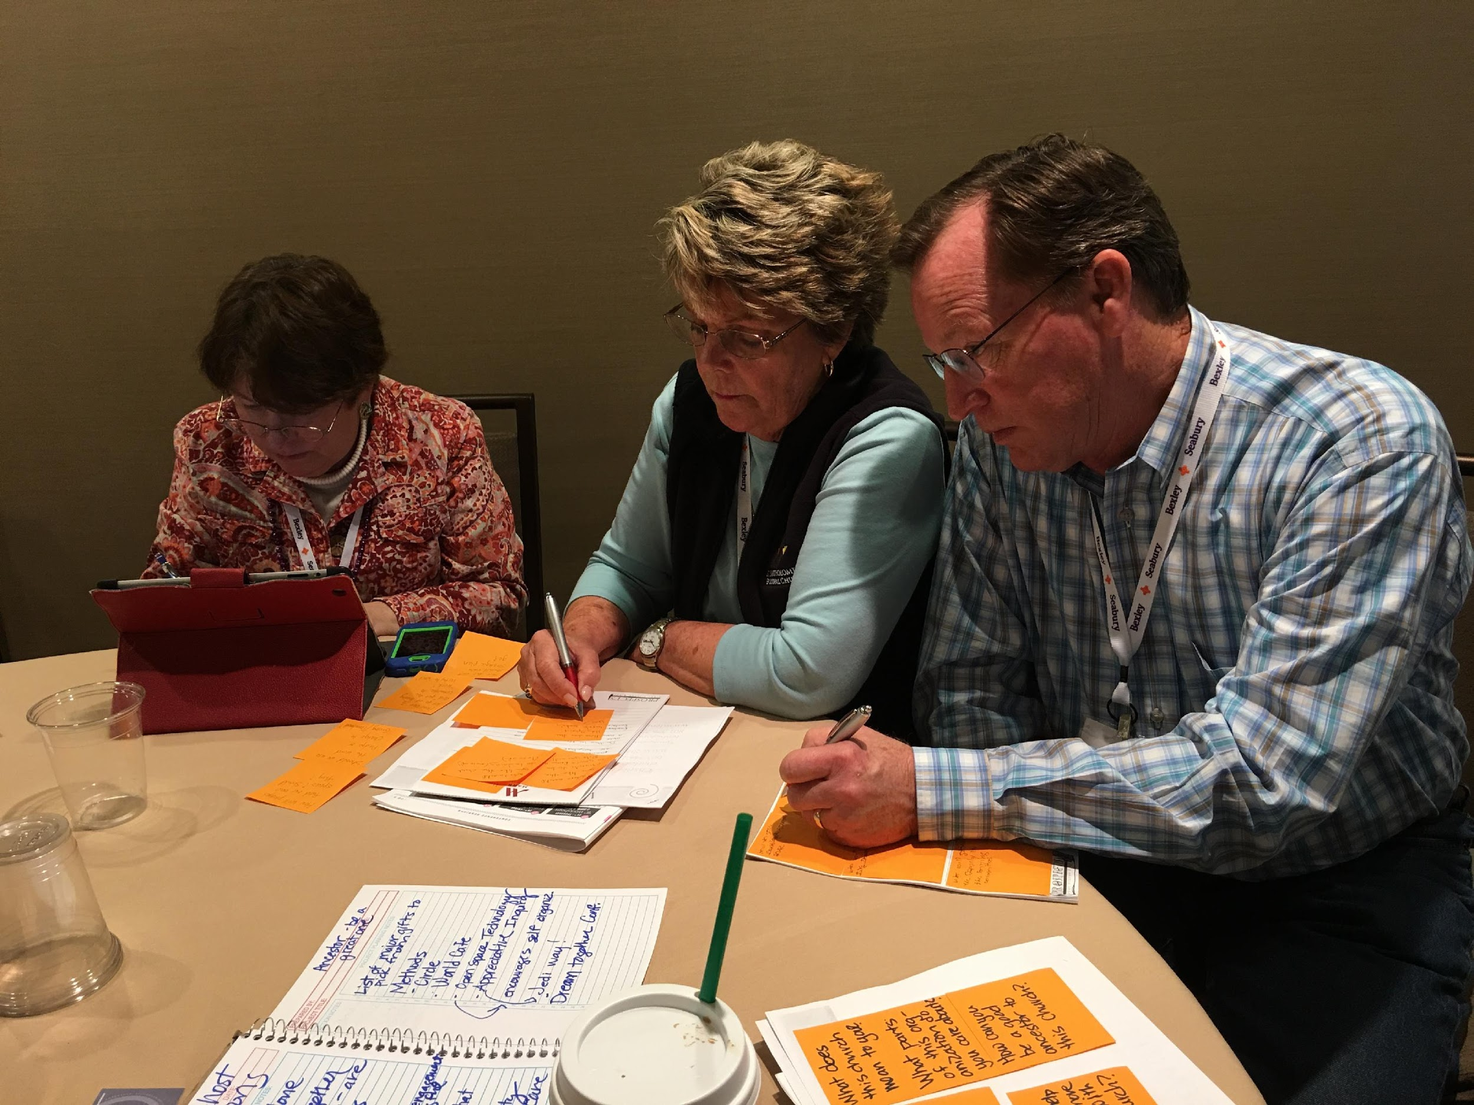
Money: Unlocking Our Hearts
Why start with money narratives?
Our relationship with things and people
Our foundational experience
Who we are, God is to us, what God’s relationship to money, and our relationship to each other.
Virtual Binder | Week 1 | Page 2

Slide 16
Money: Unlocking Our Hearts
First Exercise:
Take a moment today. Close your eyes: think about your first experience of money.
Virtual Binder | Week 1 | Page 2

Slide 17
Since the Start of the Pandemic...
Second Exercise: (Share in the Chat)
What narratives have you seen:
In the news?
In the Church?
In our homes?
Virtual Binder | Week 1 | Page 2

Slide 18
Money: Unlocking Our Hearts
We are now at a point of release. Let’s invite ourselves into new ways of being and understanding by engaging in this exercise of prayer and release.
We will release negative narratives, anxieties, thoughts, and fears and speak new life-giving thoughts and visions to those feelings.
Finally, we pray together to release those things to God.
Virtual Binder | Week 1 | Page 2

Slide 19
Money: Unlocking Our Hearts
We’ve just released….
...now let’s reimagine our framework about money.
Virtual Binder | Week 1 | Page 2

Slide 20
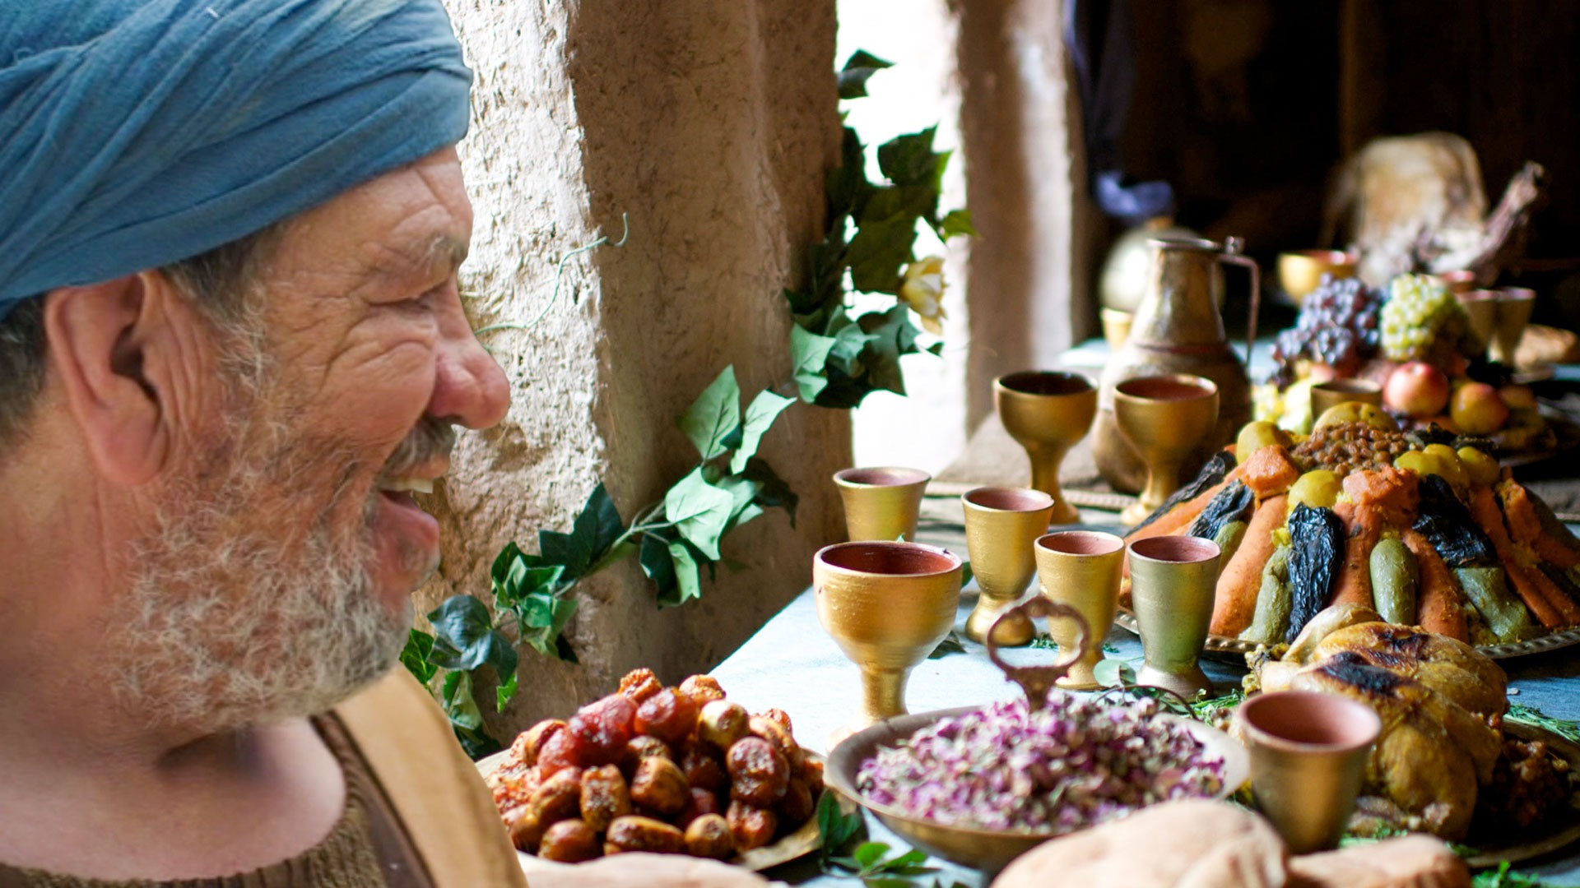
Unlocking Our Hearts/Reimagining Our Narratives
Luke 5:27-32
Jesus feasts with tax collector.
Virtual Binder | Week 1 | Page 3 | Image: LUMO Project

Slide 21
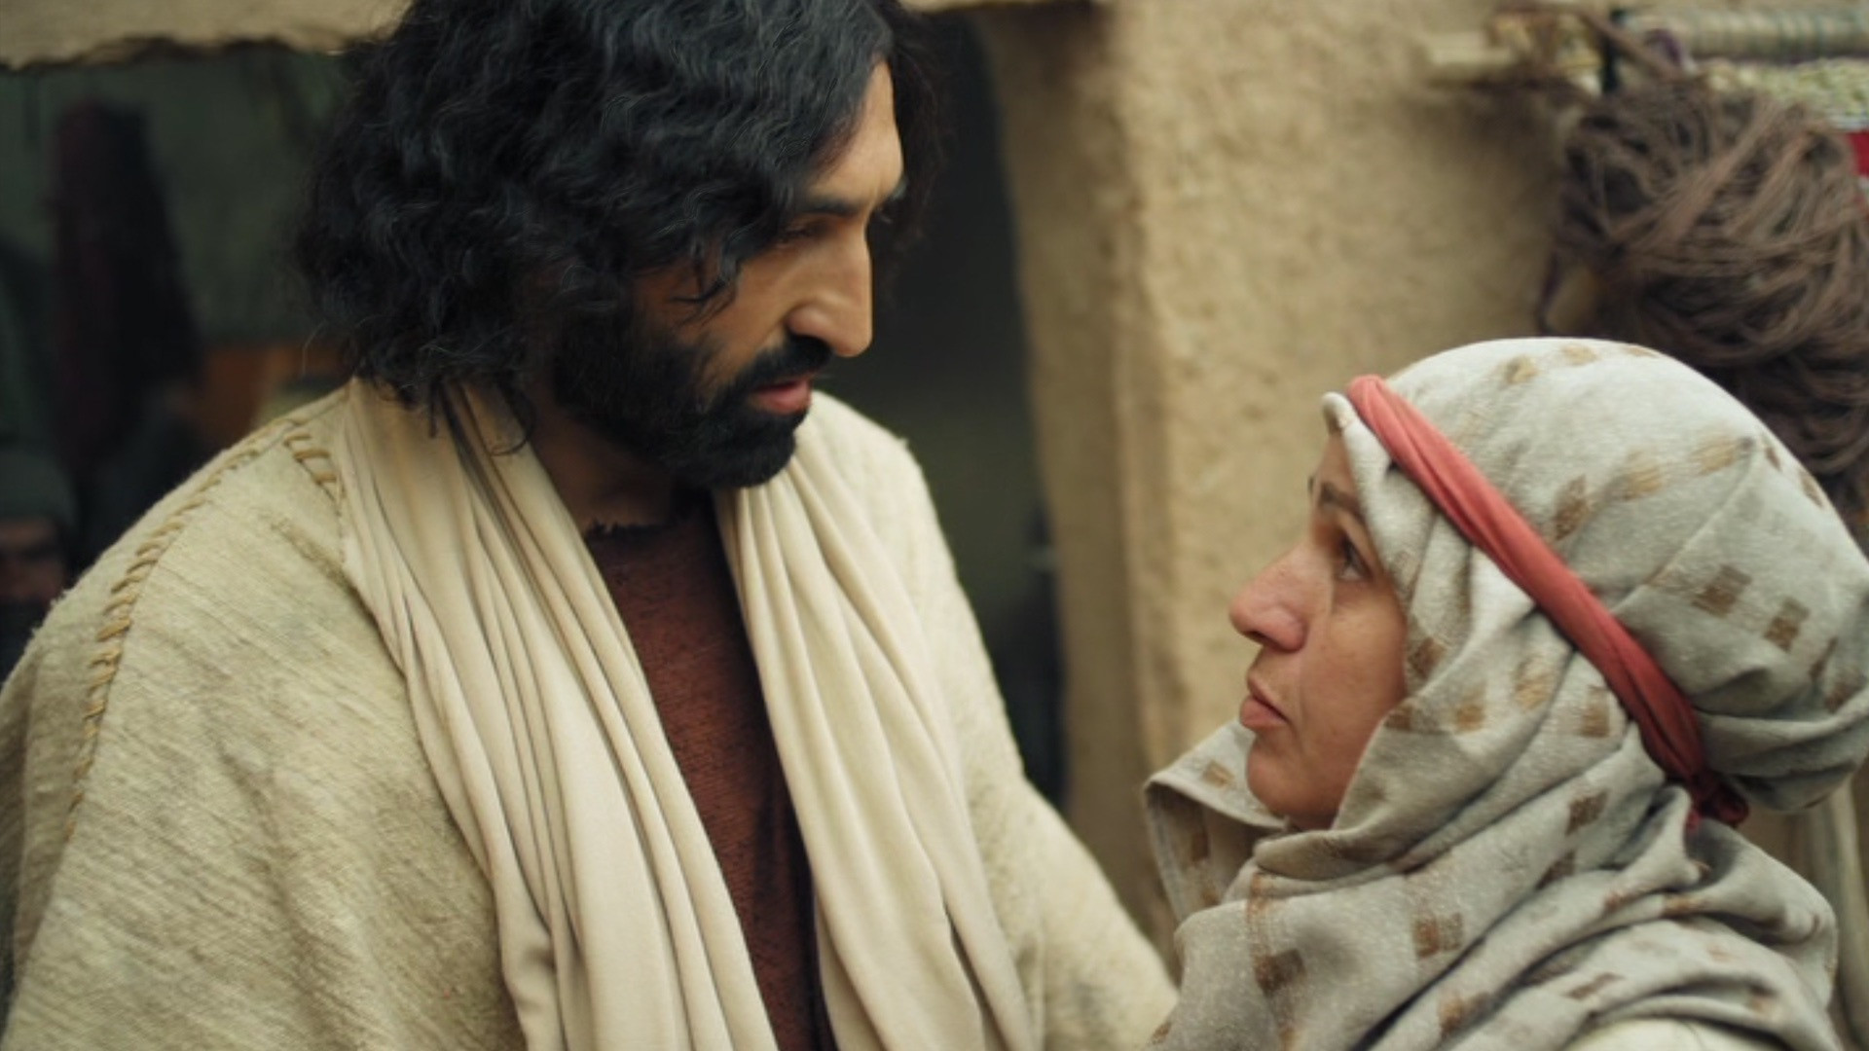
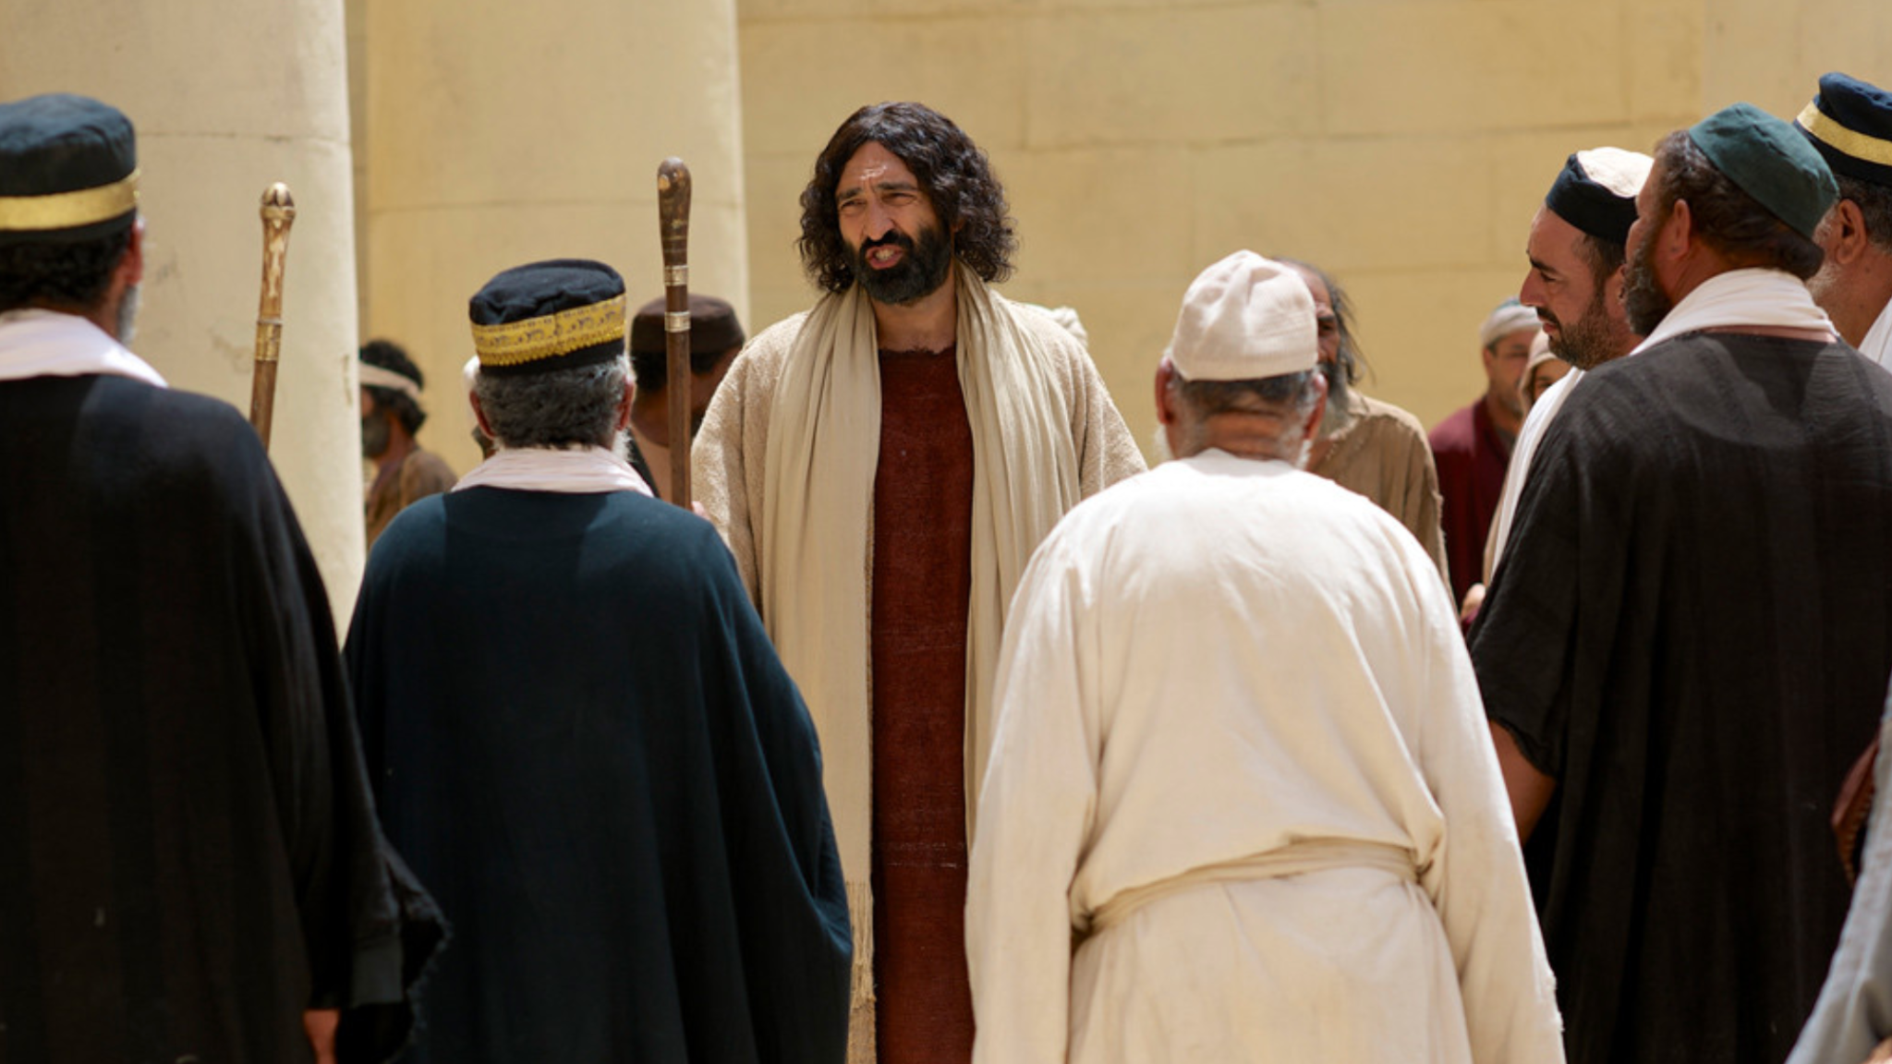
Unlocking Our Hearts/Reimagining Our Narratives
Luke 21:104
The Widow’s Mite
Virtual Binder | Week 1 | Page 3 | Image: LUMO Project

Slide 22
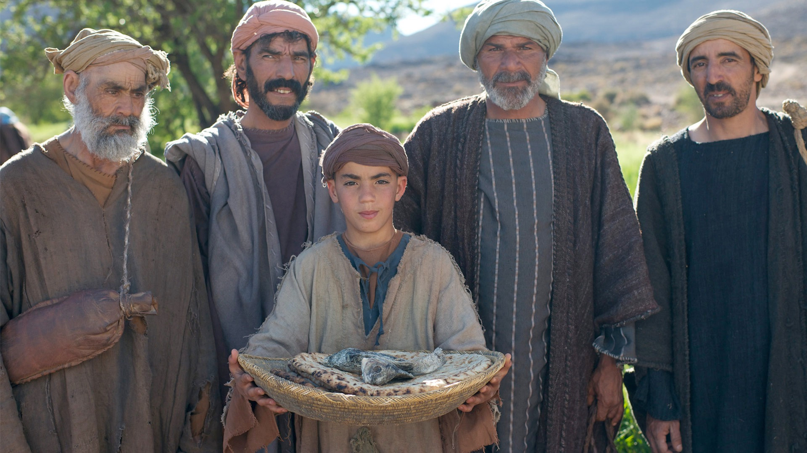
Unlocking Our Hearts/Reimagining Our Narratives
Luke 9:10-17
Feeding of the five thousand.
Virtual Binder | Week 1 | Page 4 | Image: LUMO Project

Slide 23
The Ministry of Giving
Sharing/Repairing of the World
Table Making
Fundraising Is Ministry When fundraising is ministry, lives are transformed in the giving of gifts to change and repair a broken world as we reconcile ourselves to God.
Virtual Binder | Week 1 | Page 4

Slide 24
Fundraising As Ministry
“Fundraising is a very rich and beautiful activity. It is a confident, joyful, and hope-filled expression of ministry. In ministering to each other, each from the riches he or she possesses, we work together for the full coming of God's kingdom.”
– Henri Nouwen
Virtual Binder | Week 1 | Page 5

Slide 25
Reflections about Fundraising as Ministry
Team Exercise: How do you presently think about, describe, and understand fundraising? What do you need to release, reimagine, and/or practice to view fundraising as a ministry?
Virtual Binder | Week 1 | Page 6

Slide 26
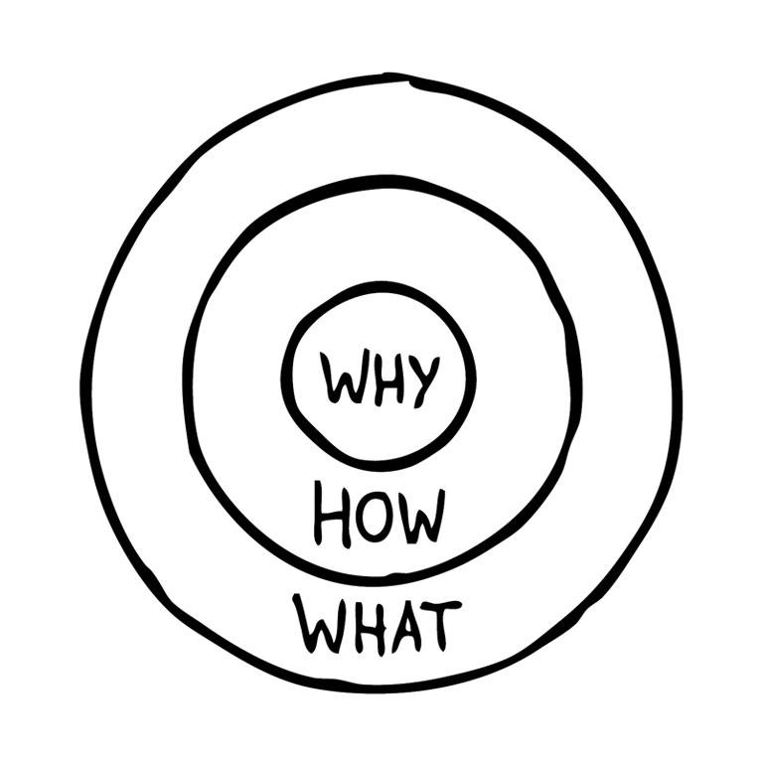
Starting with Why
Simon Sinek - “Start with Why” - How Great Leaders Inspire Action
The Golden Circle
Virtual Binder | Week 1 | Page 7

Slide 27
Starting with Why

Slide 28
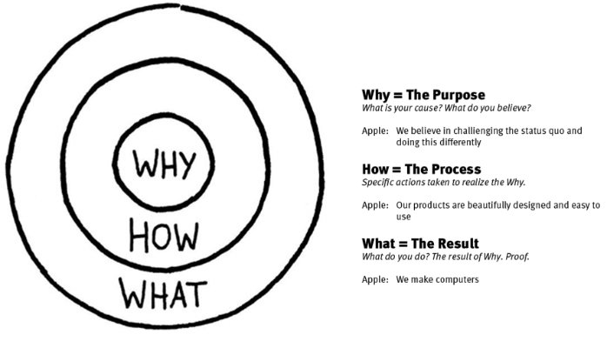
Starting with Why
What makes Apple different than other computer companies? Why do they have a cult following?
Virtual Binder | Week 1 | Page 7

Slide 29
Starting with Why
NO:
What: We make great computers. How: By proprietary processes with quality materials and smart programmers, by making user-friendly products. Why: Want to buy one?
Virtual Binder | Week 1 | Page 7

Slide 30
Starting with Why
YES:
Why: We believe in challenging the status quo. We believe in thinking differently. How: The way we challenge the status quo is by making our products beautifully designed, simple to use, and user-friendly. What: We make great products. Want to buy one?
Virtual Binder | Week 1 | Page 7

Slide 31
Starting with Why
YES:
Why: We believe giving of oneself financially unlocks a part of our hearts where God can do incredible work, both in us and through us. How: We collectively change ourselves, our Church, and our world by helping people bring their hearts and money together to grow God’s work in this world. What: Project Resource provides the tools to inspire radical generosity. Join us on the journey of changing a culture of stewardship in The Episcopal Church.
Virtual Binder | Week 1 | Page 7

Slide 32
Starting with Why
YES:
NASA’s Why/Purpose: Humankind must explore space to address fundamental questions about our place in the Universe and the history of our solar system. Through addressing the challenges related to human space exploration we expand technology, create new industries, and help to foster a peaceful connection with other nations. NASA's mission is to go to Mars. NASA’s vision is to discover new worlds, new solar systems, new life beyond our current understanding.

Slide 33
Starting with Why
Video:
Know Your Why, by Michael Jr.
Virtual Binder | Week 1 | Page 7

Slide 34
Starting with Why
What is God calling Ascension to be and do, and how?
Your Why: We believe Ascension is a place where we are called to share God’s love in the world and where faith and real life intersect.
Your How: We do this through involvement in our community, through radical hospitality, serving one another and our community, and through providing a safe place for exploring a relationship with God.
Your What: We are a vibrant place of worship, fellowship, discipleship, ministry, and mission/outreach.
Virtual Binder | Week 1 | Page 8

Slide 35
Starting with Why
What is Our Why?
1. Use "Why" to think about your church
2. Incorporate "Why" into every donor interaction
3. Tell stories… over and over and over
Amid COVID, congregations are asking “Why” in a new and important way. How has COVID given context to/reshaped your “Why”?
Virtual Binder | Week 1 | Page 8

Slide 36
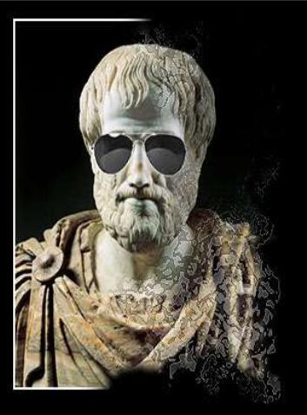
Starting with Why
Aristotle on Appeal in Rhetoric
Pathos - appealing to emotion, values
Ethos - reputation and character
Logos - reasoned discourse, demonstration of facts, statistics
Virtual Binder | Week 1 | Page 8

Slide 37
Starting with Why
Use Why, How, and What to Think About Your Church
Values (why we do mission)
Ethos (how we do mission)
Practice (what we do in our mission)
People don’t give to your church because you “do church.” They give because they’ve connected with your mission, not your mission statement. They give because you’ve communicated the Why of why you exist.
Virtual Binder | Week 1 | Page 8

Slide 38
Starting with Why
Incorporate Why into Every Donor Interaction
Invite donors to worship
Invite donors to give
Invite donors to serve
Virtual Binder | Week 1 | Page 8

Slide 39
Homework
Team Exercise: Your Whys
Why (individually/yourself) invest the time/energy/resources in stewardship/development in your own diocese/church?
Team Exercise: Release How do you presently think about, describe, and understand fundraising? What do you need to release, reimagine, and/or practice to view fundraising as a ministry?
Virtual Binder | Week 1 | Page 10

Slide 40
Homework
Team Exercise: Dreaming Together
1) What is your church’s “Why”? 2) If a million dollars was the result of a focused effort of stewardship at your church, what would that look like? (this question is vague on purpose)
Virtual Binder | Week 1 | Page 10

Slide 41
Thank You to Our Sponsors!
Vandersall Collective
VandersallCollective.com

